Slide 1
Group meeting

Slide 2



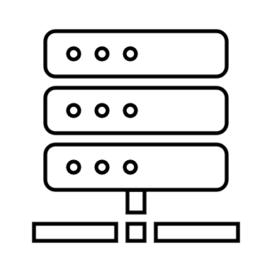






Traditional Sketch vs Distributed Sketch
F1

Slide 3
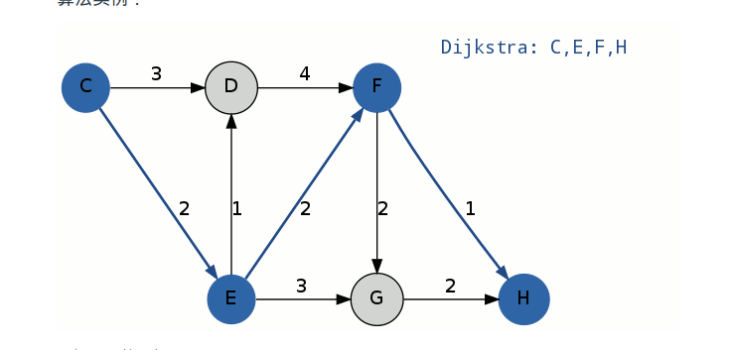
Routing algorithm
K-Shortest path :
Yen’s Algorithm
Notes:
https://www.cnblogs.com/qq952693358/p/7354070.html

Slide 4
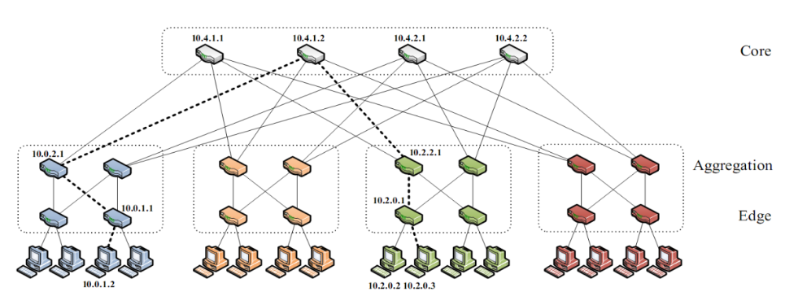
K = 4 Fat-Tree

Slide 5
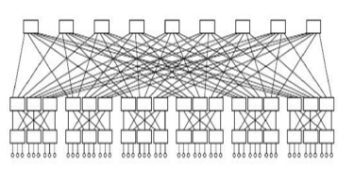
K = 6 Fat-Tree
36 37 38 39 40 41 42 43 44
18 19 20 21 22 23 24 25 26 27 28 29 30 31 32 33 34 35
0 1 2 3 4 5 6 7 8 9 10 11 12 13 14 15 16 17

Slide 6

K = 2 Fat-Tree

Slide 7


K = 4 Fat-Tree with one/two pod disable

Slide 8
Suggestion
0.有問題就問，真的
1.越自動越好
2.保留越多資料越好，不管你現在有沒有用到
3.數據記得去除極端值
4.每畫一個圖，就多開一個檔案

Slide 9
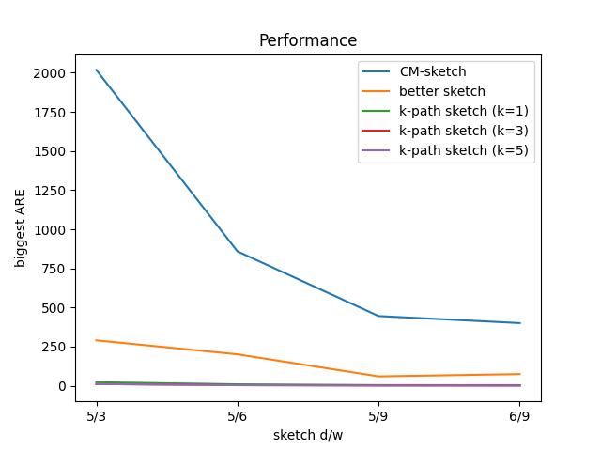
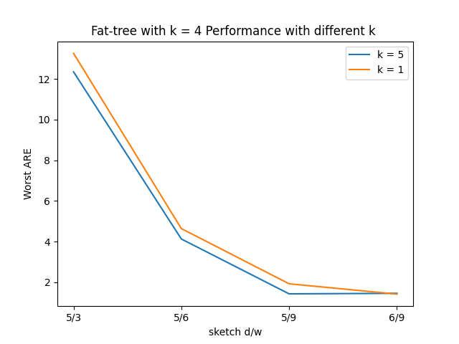
Where is weird

Slide 10
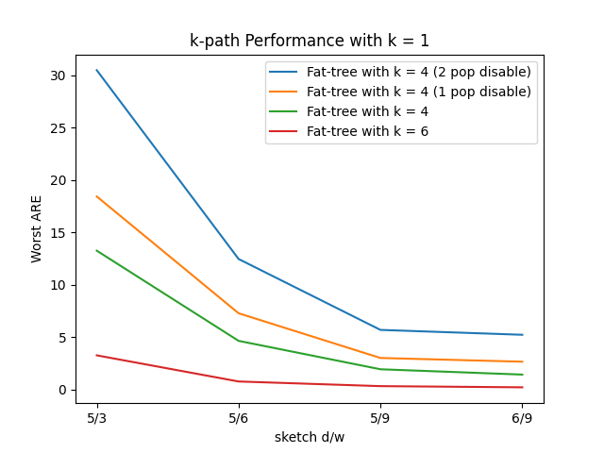
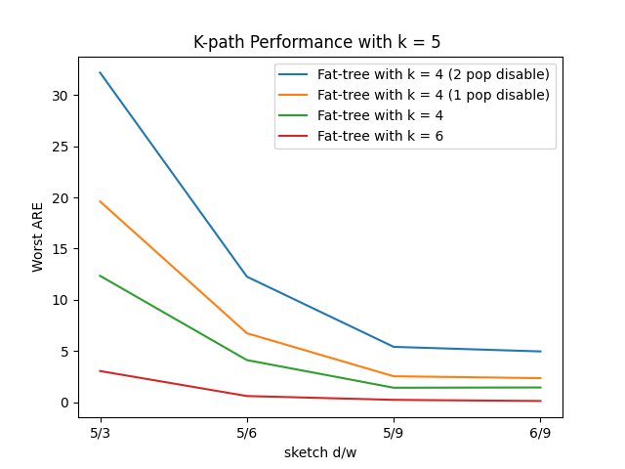

Slide 11
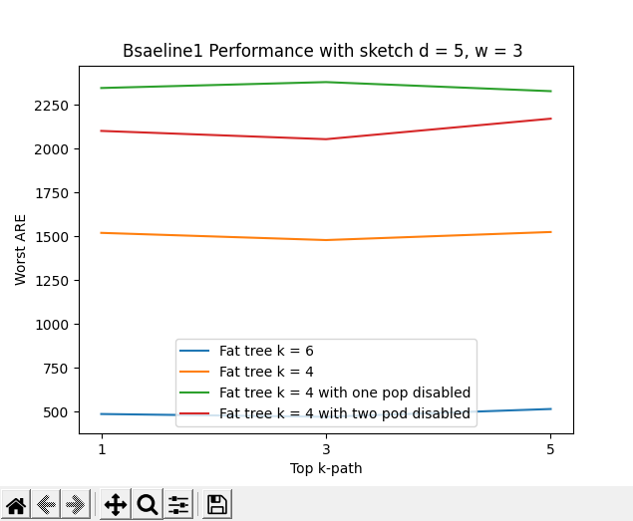

Slide 12
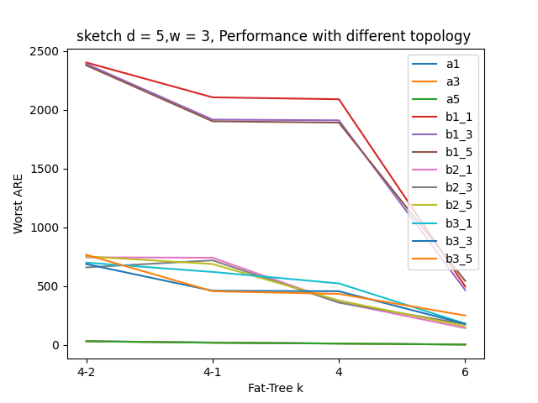
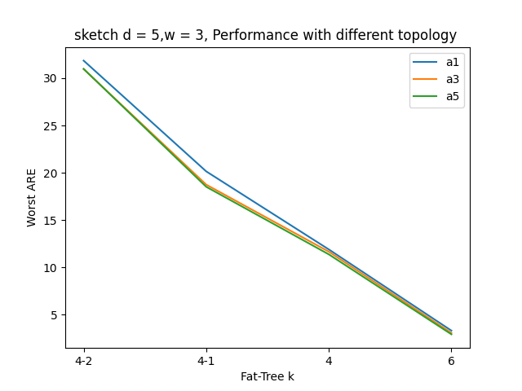

Slide 13
